Slide 1
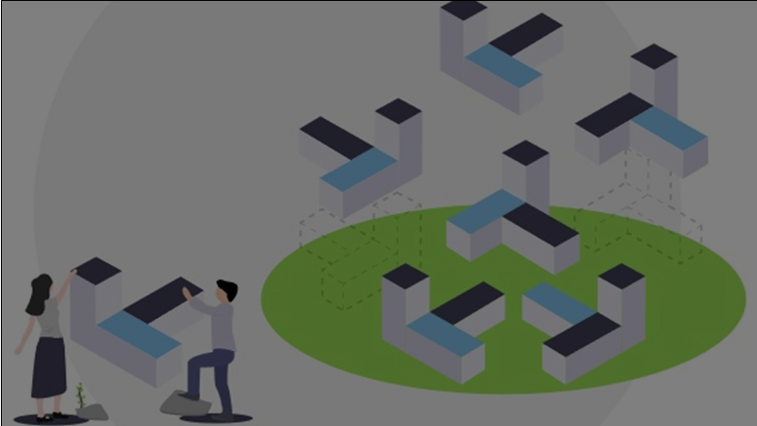

Carbon Footprint Calculator
Eco-Trek
Kelly, Denis, Merchant, Soo Yang, Julian

Slide 2





Presentation Outline
Introduction
Data Collection
Graphical User Interface
Future Developments
Conclusion

Slide 3
INTRODUCTION
(Kelly)

Slide 4
Task 3: Problem Statement
Develop a proof-of-concept of a mobile application / tool / code to track energy, water consumption, waste, and lifestyle metrics in order to calculate your carbon footprint based on reference datasets from volunteers

Slide 5
Eco-Trek
Project for tracking the ecological footprint of the user - ecology + trek (track)
Approach:
Takes in the input of energy, water consumption, waste and lifestyle metrics and outputs the user’s estimated carbon footprint
Takes reference to datasets detailing the carbon footprint of specific lifestyle metrics
Graphical User Interface (GUI) is needed to allow the user to have a smooth experience when they input their lifestyle metrics

Slide 6
DATA COLLECTION
(Denis)

Slide 7
Data Collection
Electricity Grid Emission
Food Consumption Emission
Waste Emission
Metrics
Transport Emission
Water Consumption Emission

Slide 8
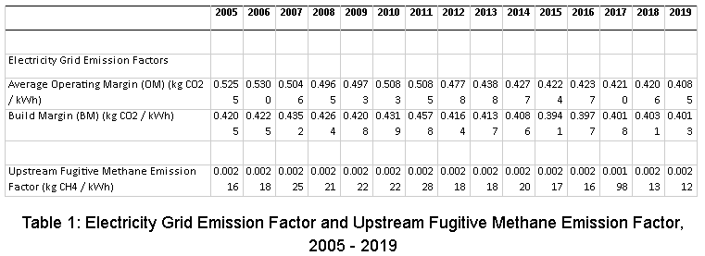
Electricity Grid Emission Metrics
Obtained from the Electricity Grid Emission Factor and Upstream Fugitive Methane Emission Factor, 2005 - 2019 provided by the Energy Market Authority (EMA)
The Grid Emission Factor (GEF) measures the average CO2 emission emitted per MWh of electricity
The 2017 and 2018 GEF have been revised to include fossil fuel-based carbon emissions from the incineration of non-plastics such as textile, rubber and leather

Slide 9
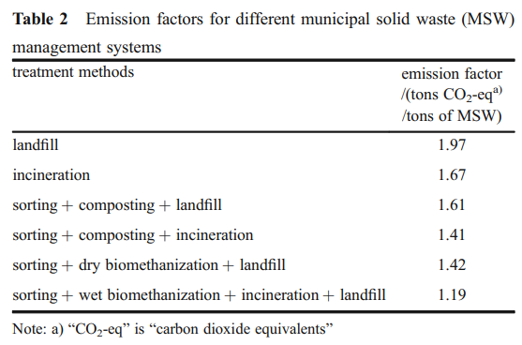
Waste Emission Metrics
The waste emission metrics are obtained from the emission factors for different municipal solid waste (MSW) management systems treatment methods. A total of 6 different methods can be identified.

Slide 10
Water Consumption Emission Metrics
The water consumption emission metrics are obtained from the following 2 tables (Not shown due to space limit)
System components for NEWater at consumer
System components for Tap water at consumer
Values are calculated based on the midpoint impact for the following categories
Climate change
Ozone layer depletion
Photochemical oxidation
Human toxicity
Particulate matter
Terrestrial acidification
Fossil depletion
Water depletion
*Midpoints are considered to be links in the cause-effect chain (environmental mechanism) of an impact category, prior to the endpoints, at which characterization factors or indicators can be derived to reflect the relative importance of emissions or extractions.

Slide 11
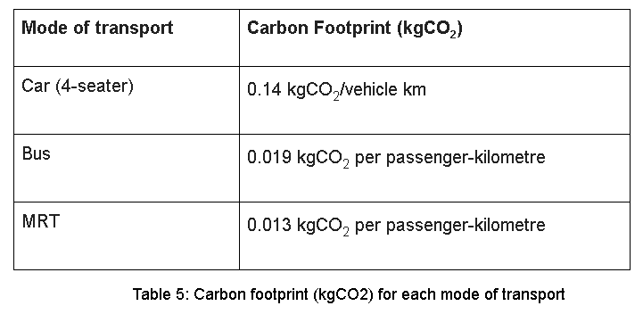
Transport Emission Metrics
The transport emission metrics are obtained from the table below. Data for 3 different modes of transport are provided. They are car (4-seater), bus, and MRT respectively.

Slide 12
Food Consumption Emission Metrics
The food consumption emission metrics are obtained from a joint study conducted by Temasek, Deloitte, A*STAR, and Singapore Institute of Manufacturing Technology ("Environmental Impact of Key Food Items in Singapore", 2019).
The study analyzes the environmental impact of key food items in Singapore.
The study quantifies the environmental impact of the production, processing and transportation stages of food in Singapore in terms of GHG emissions, energy consumption and water consumption.
The study covers 13 key food items which are the 11 items tracked by Singapore Food Agency (SFA) and 2 staples (rice and wheat).

Slide 13
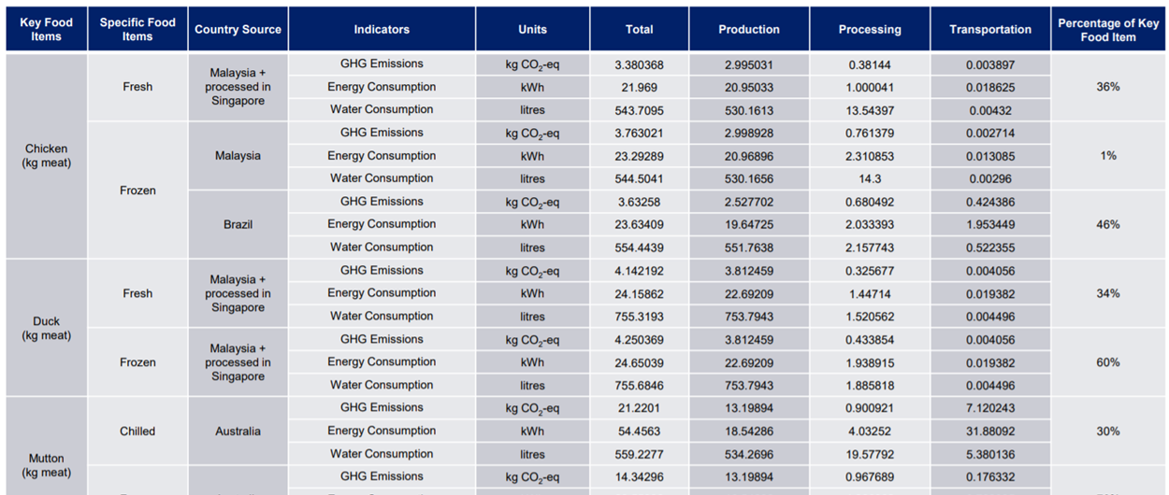
Food Consumption Emission Metrics
Environmental impact of chicken, duck, mutton

Slide 14
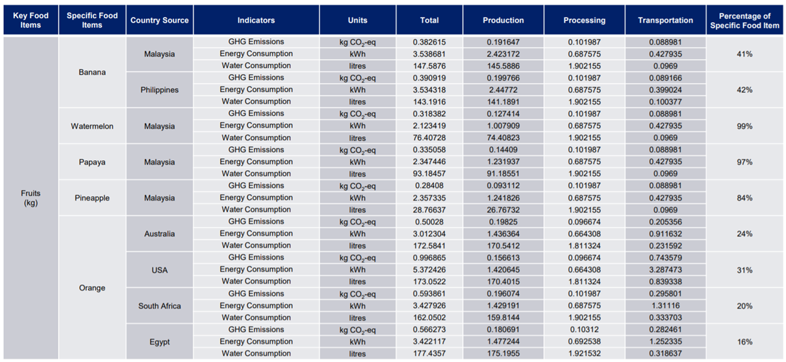
Food Consumption Emission Metrics
Environmental impact of fruits

Slide 15
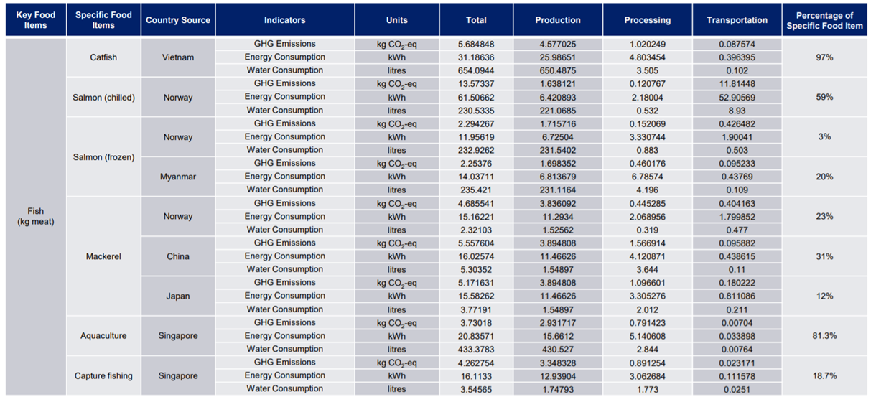
Food Consumption Emission Metrics
Environmental impact of fish

Slide 16
Graphical User Interface (GUI)
(Merchant)

Slide 17
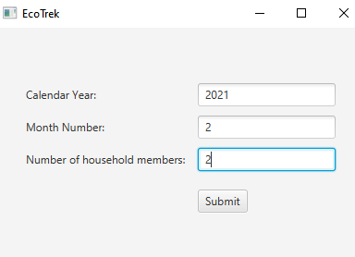
GUI - Popup Window
Asking the user to input the:
Calendar Year
Month Number
Number of household members
Valid Popup Input

Slide 18
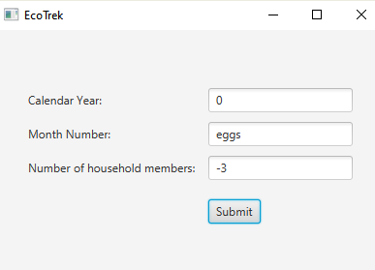
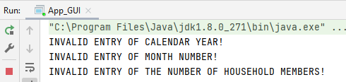
Invalid Popup Inputs

Slide 19
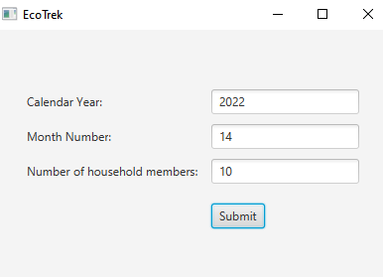
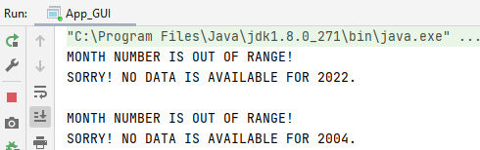
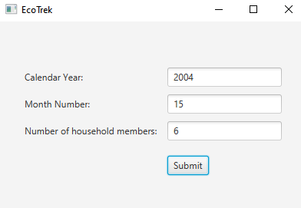

Slide 20
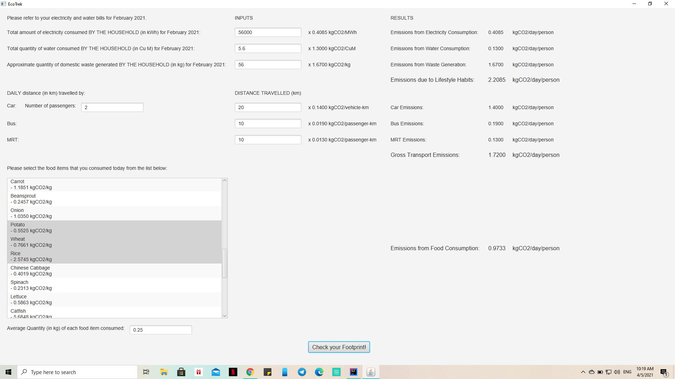

Slide 21


Slide 22
FUTURE PLANS
(Soo Yang)

Slide 23




Future Plans
Gamification of App
Monetary benefits
Medals and leaderboards
Advertisements
Government
Eco-Friendly Companies
More features
Automation
Metrics

Slide 24
CONCLUSION
(Julian)

Slide 25
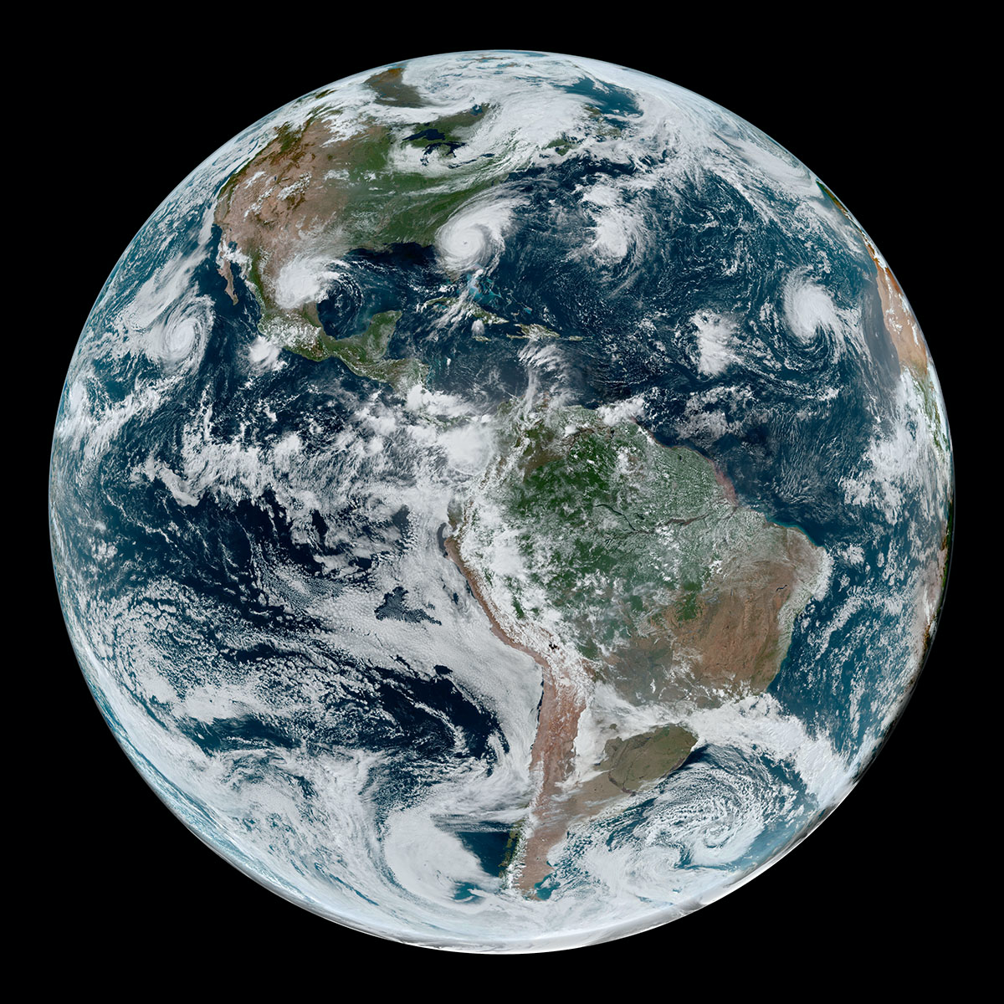
Conclusion
Eco-Trek
Eco-Trek: A Proof-of-Concept
Demonstrates that a carbon-footprint tracking app is possible
Change begins with Awareness
Eco-Trek can provide that Awareness
Our Hope: A brighter future for all
via Eco-Trek’s continued development
🌿
🌱

Slide 26


